Slide 1

BUILDING A PERSONALIZED MOVIE RECOMMENDER SYSTEM
BY
MUHAMMED ADEBISI
September 2023

Slide 2
INTRODUCTION
A Movie Recommendation System is a data-driven technology that suggests movies to users based on their preferences, viewing history, and behaviour.
A recommendation system is a system that uses data from the user to make recommendations of relevant content to the user (Falk, 2019). Movie recommendations are algorithms used to make movie suggestions to users based on their preferences and viewing history. The aim of these systems is to make recommendations which are personalized to suit the interests of the user to improve the movie-watching experience (Burke, 2007).
The rapid explosion of information thanks to the internet has made it necessary to create technologies which filter the data and direct users to only suitable and relevant information. The idea of recommendation systems emanated in the mid-90s as a means of offering a user interesting items using his profile information (Ortega et al., 2013). Over the last few decades, there have been several recommendation systems developed using a variety of approaches.

Slide 3
INTRODUCTION
KEY COMPONENTS
User Profile:
The system collects data on user preferences, including genre, actors, directors, and past viewing history.
Movie Database:
A vast database containing information about movies, including their genres, ratings, release years, and more.
Machine Learning Algorithms:
Sophisticated algorithms process user data and movie information to generate personalized recommendations.
Recommendation Engine:
The heart of the system, which calculates and ranks movie suggestions for each user.

Slide 4
BENEFITS
Personalization: Users receive movie suggestions tailored to their tastes.
Increased Engagement: Keeps users engaged and encourages more content consumption.
Revenue Generation: Can lead to increased sales and subscriptions for streaming platforms.
CHALLENGES
Cold Start Problem:
Difficulty in recommending movies to new users with limited data.
Scalability:
Handling large user bases and movie catalogues can be challenging.
Privacy Concerns:
Collecting and storing user data must be done with privacy in mind.

Slide 5
DOMAIN ANALYSIS
TYPES OF RECOMMENDATION SYSTEMS
Collaborative filtering systems make their recommendations using the ratings of users who have similar preferences to the user. They are based on the principle that if two users have had similar preferences or ratings of a movie previously, they are likely to have the same ratings for movie later. Collaborative filtering recommendations are made based on the similarity of the users’ preferences (Sarwar et al., 2001).
Content-based filtering systems make recommendations based strictly on the user’s preferences in the past by selecting movies which are similar. It relies heavily on item representation and uses the movie attributes to identify similar movies. They operate on the principle that if a user has shown a positive reception to a movie in the past, they would enjoy a movie with similar features (Pazzani & Billsus, 2007).
Hybrid systems combine both approaches, using their strengths and overcoming their weaknesses to make their recommendations. The combination of the strengths of these approaches helps to make the recommendations more accurate (Burke, 2002). This combination to produce hybrid systems can be done in different ways such as the mixed, cascade, feature combination, weighted and switching methods (Burke, 2002).

Slide 6
TYPES OF RECOMMENDATION SYSTEMS
In summary
Collaborative Filtering:
Recommends movies based on the preferences and behaviours of similar users.
Content-Based Filtering:
Recommends movies similar to those a user has previously liked.
Hybrid Models:
Combine collaborative and content-based approaches for improved accuracy.

Slide 7
OBJECTIVE OF STUDY
The project involves implementing a recommendation system that combines collaborative filtering and content-based filtering, evaluating various machine learning algorithms, preprocessing and analyzing the MovieLens Dataset, creating a user-friendly website for user interaction, and assessing the recommendation system's performance.

Slide 8
HOW IT WORKS
Data Collection:
User interactions (ratings, likes, searches) are gathered to build user profiles.
Data Preprocessing:
Data is cleaned, transformed, and prepared for machine learning algorithms.
Feature Engineering:
User and movie data are transformed into numerical features for modeling.
Machine Learning Models:
Algorithms like collaborative filtering, content-based, or hybrid models are used to make predictions.
Recommendation Generation:
The system suggests movies by predicting user preferences and ranking them accordingly.

Slide 9
PYTHON IN DATA ANALYSIS
Python is a valuable choice for this project because it is a widely-used programming language in data analysis, known for its simplicity, versatility, and numerous libraries. Python's libraries like Pandas, Seaborn, NumPy, and Matplotlib provide essential tools for data manipulation and visualization. Additionally, Python offers specialized libraries like Surprise and Implicit for recommendation system development, with algorithms like collaborative filtering and implicit feedback support. Moreover, Python's machine learning libraries like Scikit-learn and TensorFlow enable the implementation of content-based and hybrid recommendation systems, providing a wide array of algorithms and deep learning models for feature extraction and preference prediction.

Slide 10
ABOUT THE DATASET
The MovieLens 25M dataset is a popular and widely used dataset in the field of recommendation systems and movie-related research. It contains a substantial amount of data related to movie ratings and user interactions. Here's some key information about the MovieLens 25M dataset:
1. Dataset Size:
The "25M" in the dataset's name indicates that it contains 25 million ratings and other interactions. This makes it a large and comprehensive dataset for movie recommendation research.
2. Data Types:
The dataset includes various types of data, including movie ratings, user IDs, movie IDs, timestamps, and user-generated tags.
3. Ratings:
Users in the dataset have provided ratings (usually on a scale of 1 to 5) for movies they've watched. These ratings are a fundamental component for building recommendation systems.
4. User IDs and Movie IDs:
Each user and movie is identified by a unique ID, allowing researchers to track user preferences and movie details.

Slide 11
ABOUT THE DATASET
5. Timestamps:
Timestamps are included to indicate when a user rated or interacted with a movie. This temporal information can be useful for understanding how user preferences change over time.
6. Tags:
Users can also provide tags to describe movies. These tags can be used for content-based recommendation or additional context.
7. Diversity of Movies:
The dataset covers a wide range of movies from different genres, release years, and popularity levels. This diversity makes it suitable for various recommendation research scenarios.
8. Use Cases:
The MovieLens 25M dataset is commonly used for training and evaluating recommendation algorithms, such as collaborative filtering, content-based filtering, matrix factorization, and deep learning-based models.
9. Research and Development:
Researchers and data scientists use this dataset to develop and benchmark recommendation algorithms, conduct experiments, and study user behaviour in recommendation systems.

Slide 12
ABOUT THE DATASET
10. Data Exploration: - Researchers can perform exploratory data analysis to gain insights into user preferences, movie popularity, and other factors influencing recommendations.
11. Availability: - The MovieLens 25M dataset is freely available for research purposes and can be downloaded from the MovieLens website.
In summary, the MovieLens 25M dataset is a valuable resource for building and evaluating recommendation systems. Its large size, diverse movie selection, and inclusion of user ratings and tags make it a rich source of data for research in the field of recommendation systems and movie-related analytics.

Slide 13
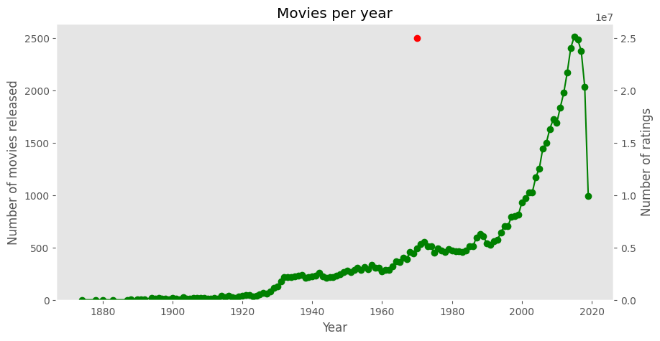
VISUALIZATIONS FROM THE DATASET
The line plot below shows the trend in movies per year from 1880 to 2021.
We can notice a significant increase in movies per year and then a decrease between 2019 and 2021 which can be attributed to COVID pandemic.

Slide 14
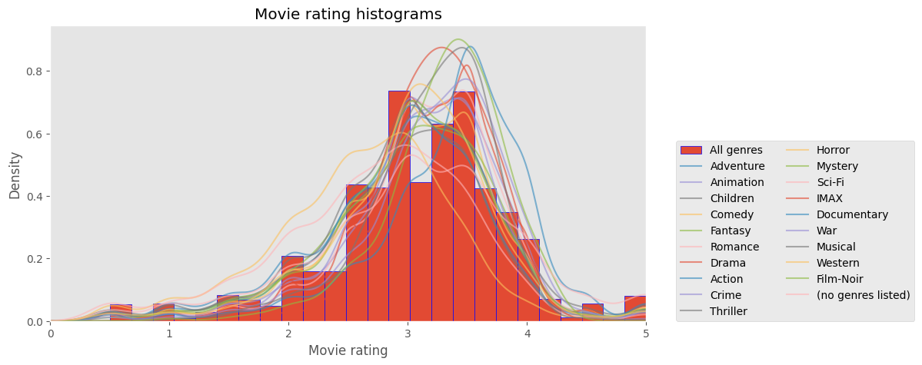
VISUALIZATIONS FROM THE DATASET
The histogram below shows the ratings of movies.
It is noticeable that the 2.9 and 3.4 (most common) have the highest ratings in the dataset
Some genres have higher ratings on average

Slide 15
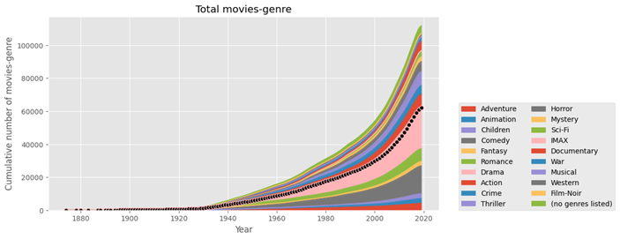
VISUALIZATIONS FROM THE DATASET
The cumulative plot below shows the total number of genres in movies per year from 1880 to 2021.
Sci-fi & Romance have an increasing cumulative over the years which means they have more movies when cumulated.

Slide 16
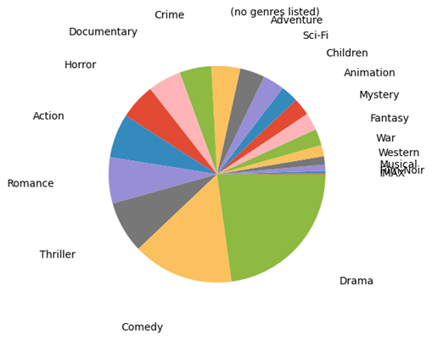
VISUALIZATIONS FROM THE DATASET
The pie chart plot illustrates that the Drama, Comedy, Thriller and Romance genres make up for more than 50% of the movie genres produced.
Drama genre has the most movies produced followed by the Comedy Genre

Slide 17
STEPS TO TAKE
Divide the dataset into training, validation, and test sets to evaluate the performance of the recommender system.
Decide on the type of recommender system (e.g., collaborative filtering, content-based, matrix factorization, deep learning, hybrid).
Consider using pre-built libraries or frameworks like Surprise, scikit-learn, or TensorFlow for implementation.
Train the recommender system model on the training data
Evaluate the model's performance on the validation and test datasets.
Conduct A/B testing or user studies to validate the effectiveness of the recommender system.
Deploy the recommender system in a production environment, either as part of a website, app, or standalone service.
Collect user feedback and interactions to improve recommendations over time.
Privacy and Security
Documentation and Reporting
Continuously iterate on the recommender system, incorporating user feedback and exploring new techniques to enhance recommendation quality.

Slide 18
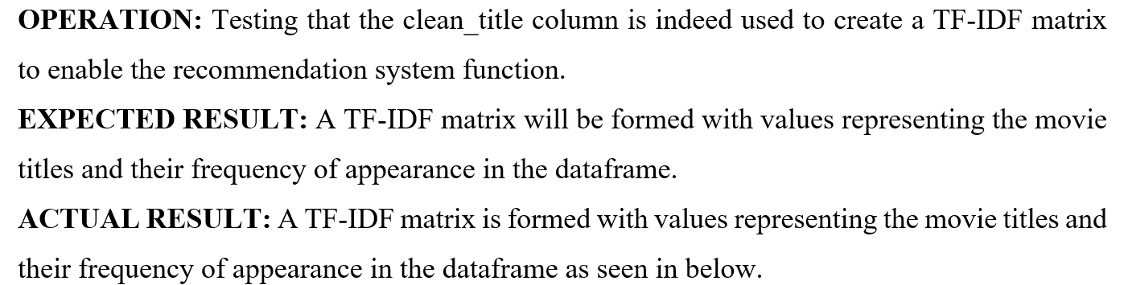
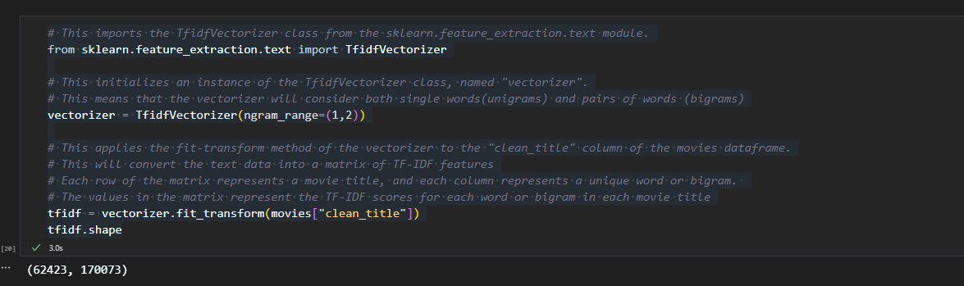
RESULTS

Slide 19
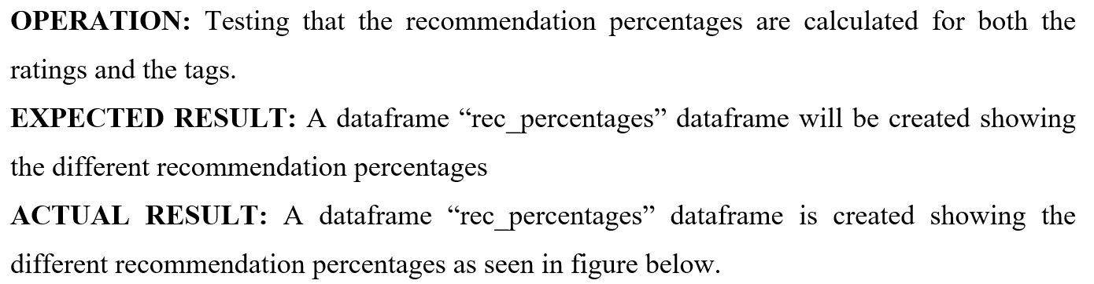
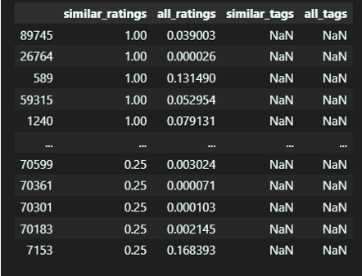
RESULTS

Slide 20
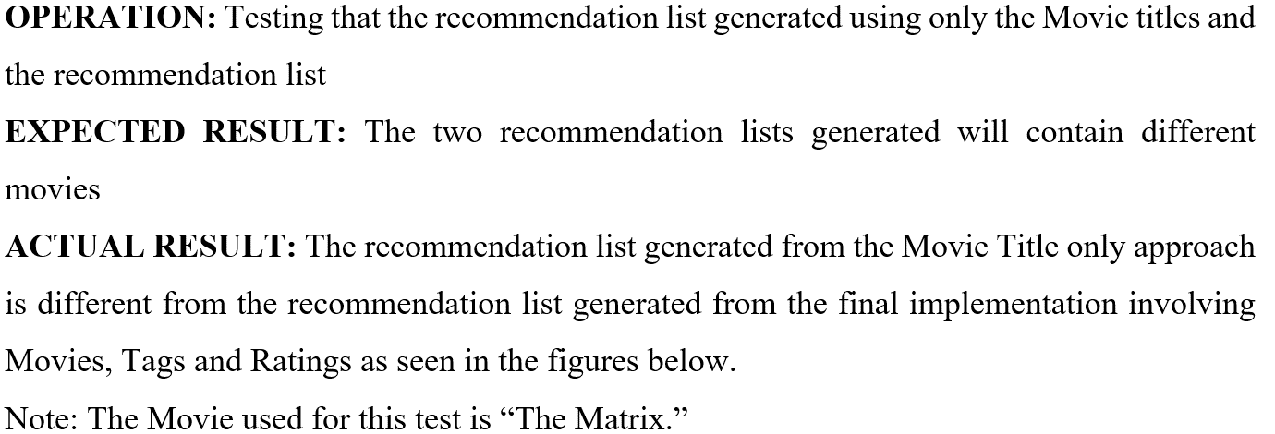
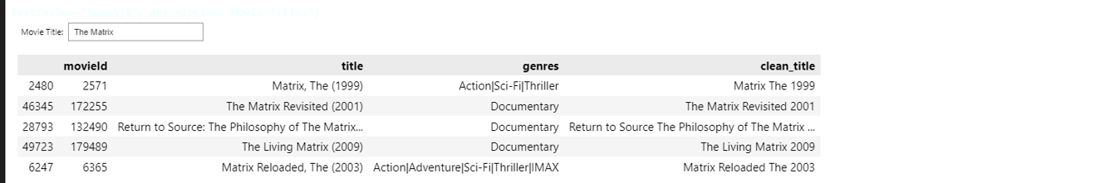
RESULTS

Slide 21
RESULTS

Slide 22
CONCLUSION
It was therefore concluded that from this project, an effective movie recommendation system was implemented using the Python programming language and its libraries such as Pandas, Numpy, Scikit-Learn and ipywidgets, the MovieLens Dataset, and an unorthodox use of cosine similarities for the calculation of recommendation percentages. This project demonstrated a new approach to solving the cold start problem and generating movie recommendations.

Slide 23
FUTURE WORKS ANS RECOMMENDATIONS
Also, due to time constraints, not all files in the MovieLens 25m dataset were used in building the recommendation system. Three of the six files in the dataset were unused i.e., the Genome-tag, Genome-Scores, and the Links files. Using the genome-tags and genome-scores creates a student project opportunity for further collaboration to develop the recommendation system further. The original source code of this project could be further extended to contain a vast number of algorithms necessary to create recommendations that surpass even the current industry standards.
A web application could also be developed to allow more users interact with the recommendation system without having to load or setup Python environments or Jupyter Notebooks. This would expand the accessibility of the system, allowing usage of a wider range of devices. To maintain a continuously evolving and efficient system, I would also like to evaluate the performance of the system on a regular basis using feedback from surveys and questionnaires submitted by the users of this research soon.

Slide 24
THANK YOU

